Slide 1
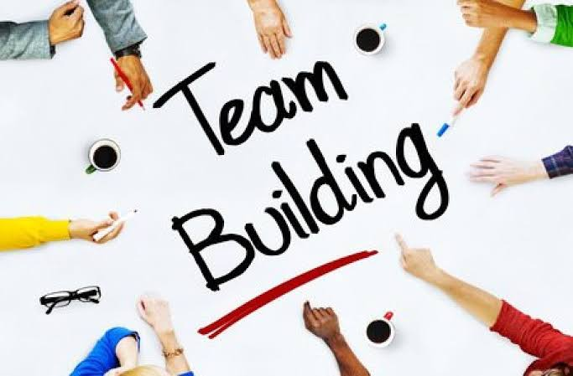

Slide 2

Course outline
Team Building
Reasons for team building
Stages of Team Building
Importance of Team Building
Benefits of Team Building

Slide 3
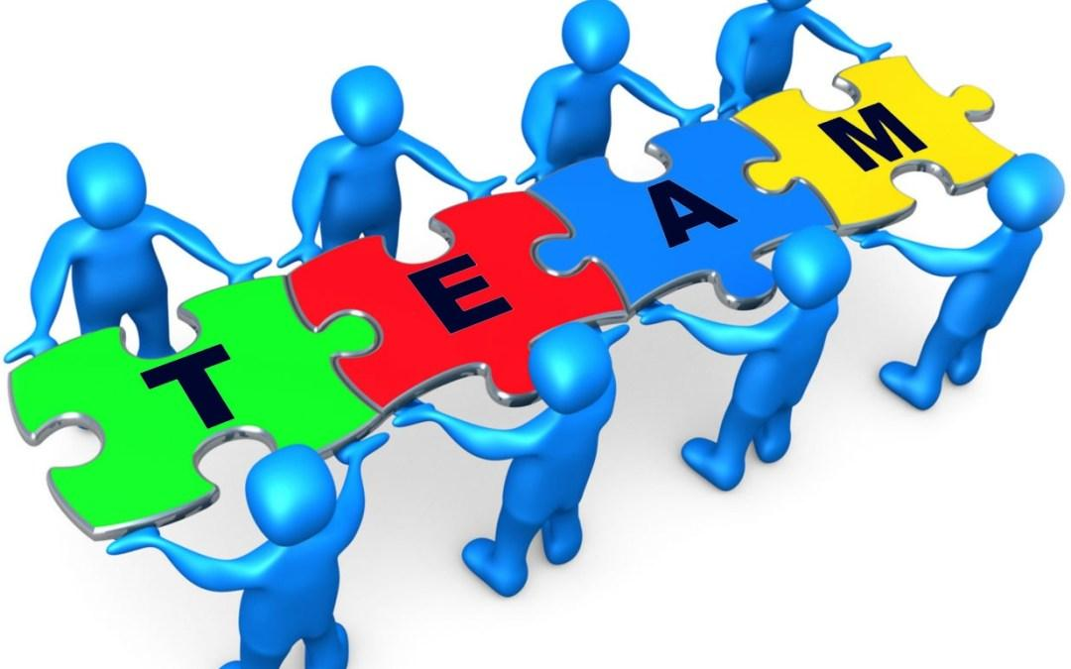
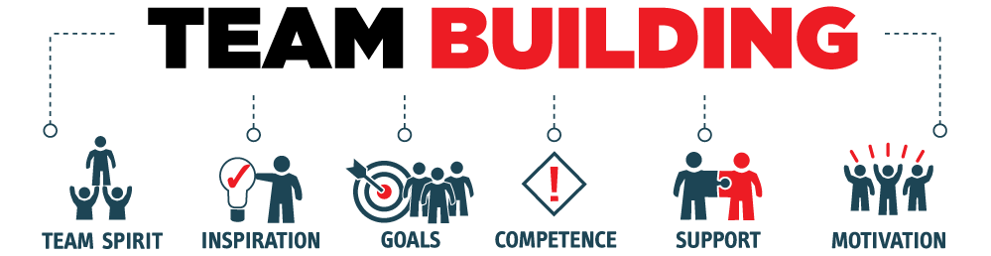
Definitions
Team
Teamwork
Team player
Team building
Notes:
“A team is a small group of people with complementary skills who are committed to a common purpose, set of performance goals and approach for which they make themselves mutually accountable.’’ (Katzenbach and Smith, 1993)
Teamwork
Concept of people working together as a team
Team player
A team player is someone who is able to get along with their colleagues and work together in a cohesive group
Team Building
Process of establishing and developing a greater sense of collaboration and trust between members

Slide 4

Why Should We Be a Team?
  “To provide accurate information that would assist individuals in achieving a better quality of life.”
Notes:
When staff use their skills and knowledge together, the result is a stronger agency that can fulfill its mission.
People working together can sustain the enthusiasm and lend support needed to complete the work of each program

Slide 5
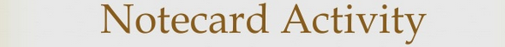

Notes:
Give students a note card and tell them to write down three interesting facts (characteristics, significant events, accomplishments, etc.) about themselves
They should not write their names on the cards
When there are finished, collect the cards
Have the students randomly choose one of the cards and have the group guess whose card it is based on the facts

Slide 6


Types of teams
Working Group
Pseudo- Team
Potential Team
Notes:
WORKING GROUP
No common purpose other than to complete the task at hand
Focus on individual performance
Results might be achieved
PSEUDO TEAM
No interest in a common purpose
No focus on collective performance
Individual interest of members detracts from each other
No coordinated action
POTENTIAL TEAM
Collaborative effort but no mutual accountability
Ineffective in overcoming barriers
May be the beginning of a real team

Slide 7

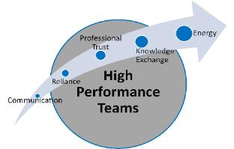
Types of teams
Real Team
High Performance Team
Notes:
REAL TEAM
Complementary skills
Commitment to team purpose and performance
Mutual accountability
Able to overcome barriers
Basic unit of performance
HIGH PERFOMANCE TEAM
Meets all conditions of Real team
Members deeply committed to one another's personal growth & success
Significantly outperforms all other like teams
Incremental results

Slide 8
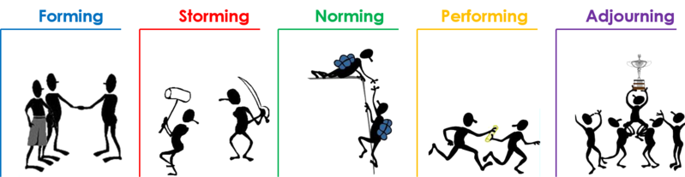
Stages in Team Building
Notes:
As the team matures, members gradually learn to cope with each other and the pressures that they face. As a result, the team goes through the fairly predictable stages noted on the slide.

Slide 9

Forming Stage
Notes:
Forming
The Team
defines the problem
agrees on goals and formulates strategies for tackling the tasks
determines the challenges and identifies information needed
Individuals take on certain roles
develops trust and communication

Slide 10
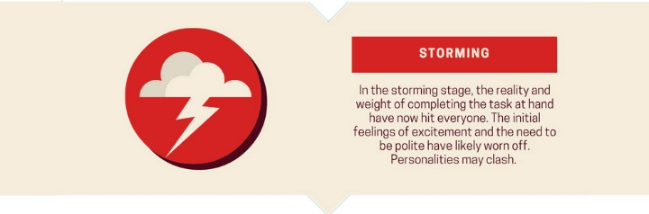
Storming Stage
Notes:
Storming
The Team members
Realise that the task is more difficult than they imagined
Have fluctuations in attitude about chances of success
May be resistant to the task
Have poor collaboration

Slide 11

Norming Stage
Notes:
Norming
The Team members accept:
their team
team rules and procedures
their roles in the team
the individuality of fellow members
Team members realise that they are not going to crash-and-burn and start helping each other.

Slide 12
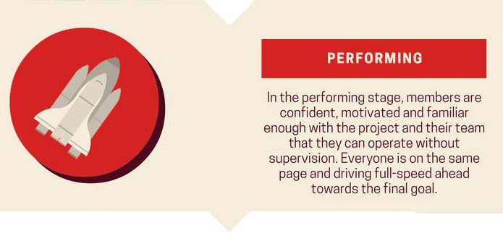
Performing Stage
Notes:
Performing
The Team members
gained insight into personal and team processes
a better understanding of each other’s strengths and weaknesses
gained the ability to prevent or work through group conflict and resolve differences
developed a close attachment to the team
During the performing stage, the team is now an effective and cohesive unit. As a team, the emphasize quality work; utilize each member’s talents; meet deadlines; and continue to work on team commitment.

Slide 13

Adjourning Stage
Notes:
Adjourning
Team:
Accomplishes their goals
Review the past weeks to take notice of their weaknesses and celebrate their successes
Is disbanded

Slide 14

IMPORTANCE OF TEAM BUILDING
Better communication
Better relationships
Increase in productivity
Notes:
Facilitates better communication – Activities that create discussion enable open communication among employees, and between employees and management. This can improve office relationships and in turn, the quality of work done.
Motivates employees – Team leadership and team building go hand in hand. The more comfortable your employees are to express their ideas and opinions, the more confident they will become. This will motivate them to take on new challenges.
Promotes creativity – Taking a team outside of an office setting and exposing them to new experiences will force them to think outside of their normal routine. Working together with other team members can ignite creativity and fresh ideas, which are great qualities to bring back to the office.
Develops problem-solving skills – In public relations a crisis can happen at any time. Team building activities that require coworkers to work together to solve problems can improve the ability to think rationally and strategically. Teams that are able to determine when a problem arises and know what they can do about it, can then effectively take charge when a real crisis occurs.
Breaks the barrier – Team building increases the trust factor with your employees. Often in corporate settings there is a disconnect between the leadership team and employees because the employees sense too large of a gap between the two. Team building exercises give leadership the opportunity to be seen as a colleague rather than a boss, which can do wonders for employee morale

Slide 15
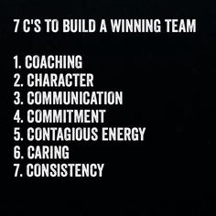

Slide 16
Benefits of team work
Increases innovation
Strengthens team members
Increases productivity
Improves leadership skills
Improves job satisfaction

Slide 17
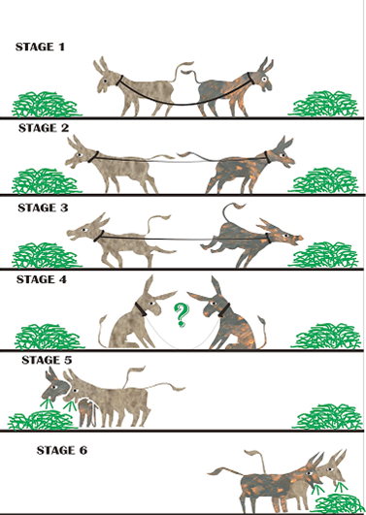

Slide 18
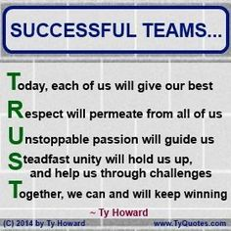

Slide 19
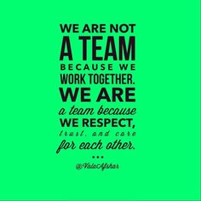

Slide 20
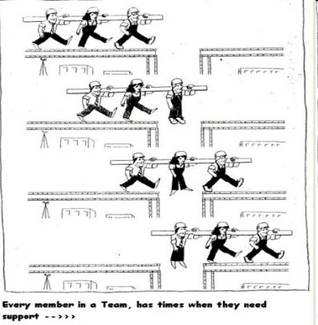

Slide 21
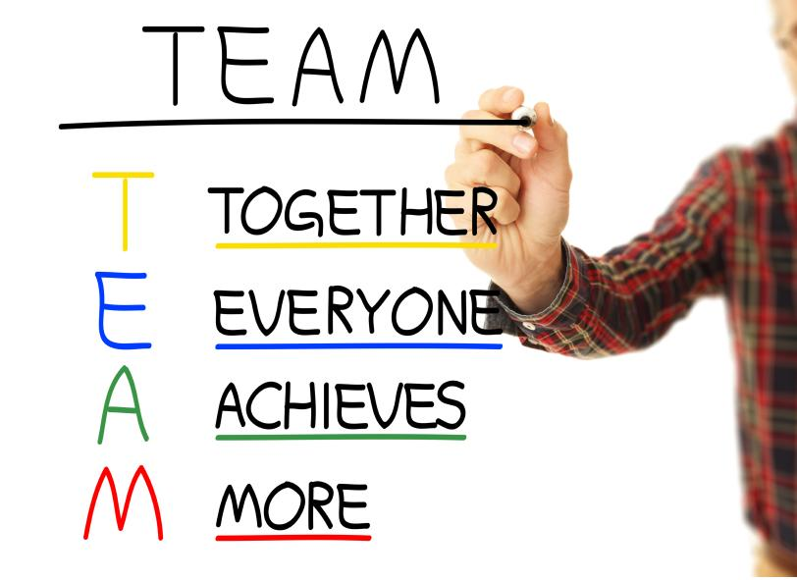
CONCLUSION
I can do what you can’t do and you can do what I can’t do; together we can do great things - (Mother Teresa, n.d)
Leadership plays a very major role in team building
Everything rises and falls on leadership - (John C. Maxwell, 2002)
Leadership is influence, nothing more, nothing less – (John C. Maxwell, 2002)

Slide 22


